Slide 1
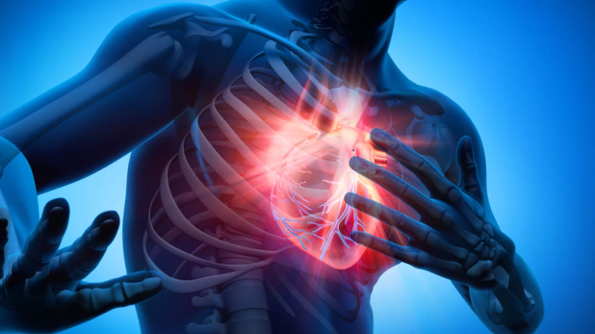
Heart diseases
Data Science Bootcamp Project

Slide 2
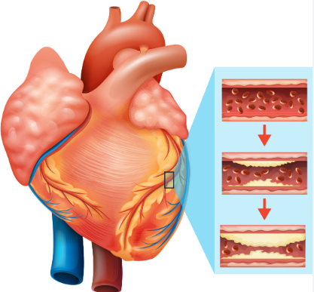
Index
Back End
Data exploration and cleaning
Analysis
Machine Learning
Front End

Slide 3
Index
Back End
Data exploration and cleaning
Analysis
Machine Learning
Front End

Slide 4
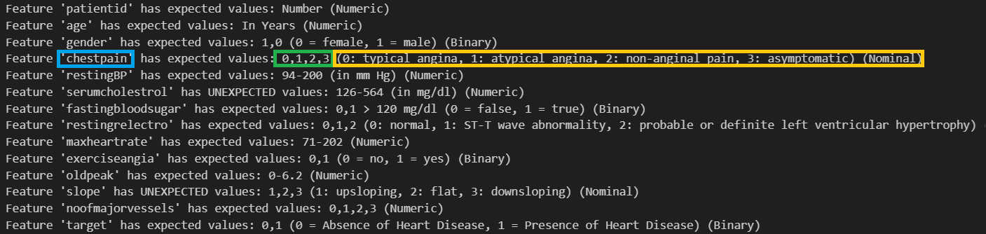
Data exploration and cleaning
No nulls
No duplicate rows

Slide 5
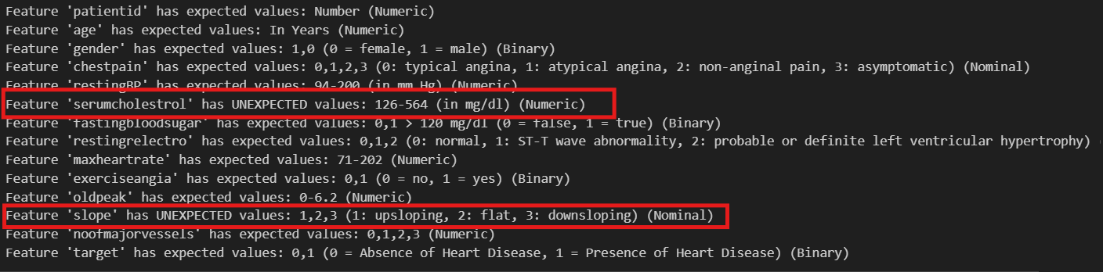
Data exploration and cleaning

Slide 6
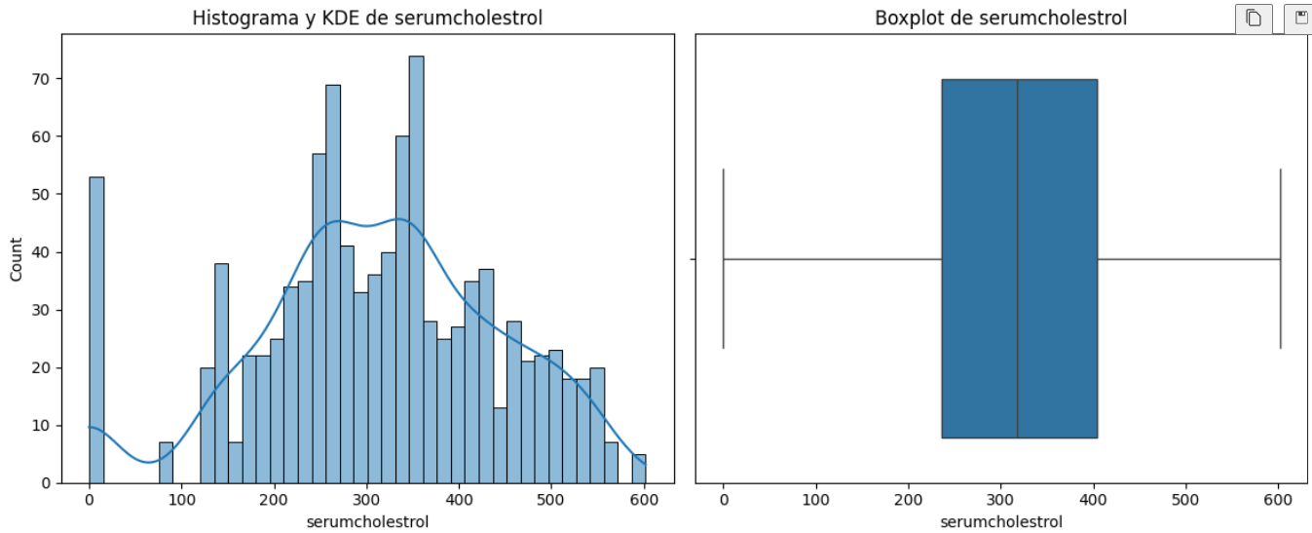
Data exploration and cleaning
Serumcholesterol
Serum cholesterol: Values between 126 – 564 mg/dl.

Slide 7
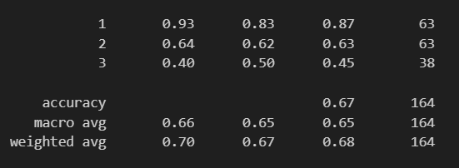
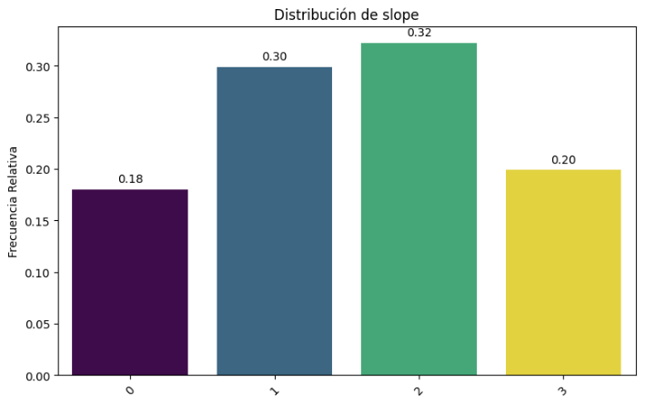
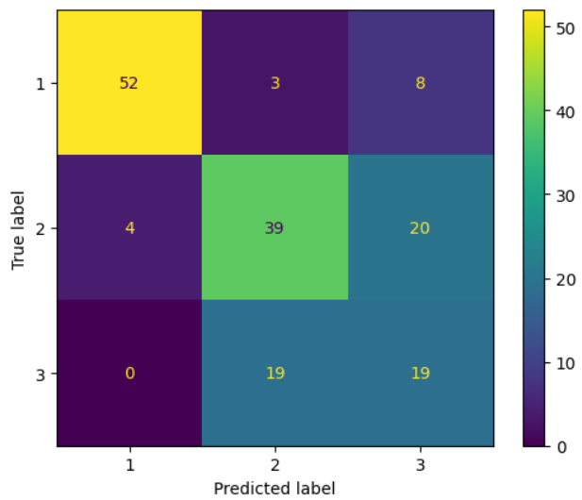
Data exploration and cleaning
Random Forest Classifier
Slope
Slope:
1: upsloping
2: flat
3: downsloping

Slide 8
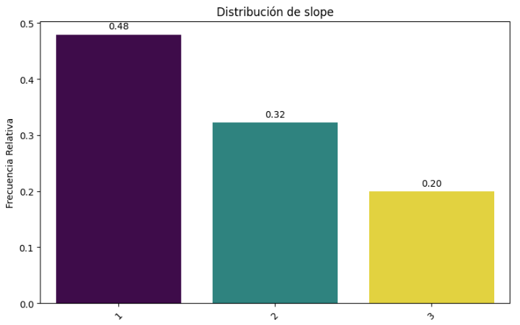
Data exploration and cleaning
Slope

Slide 9
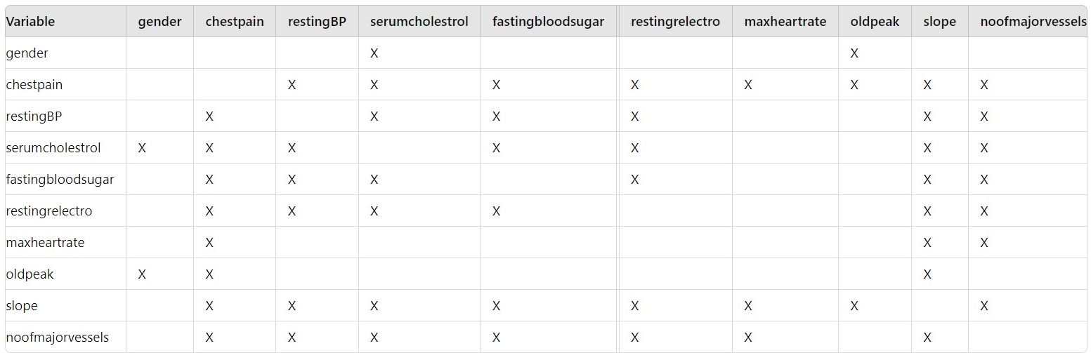
Analysis
Against the target, the following features are not relevant: patientid, exerciseangia, age, gender, oldpeak
These features are relevant between them:

Slide 10
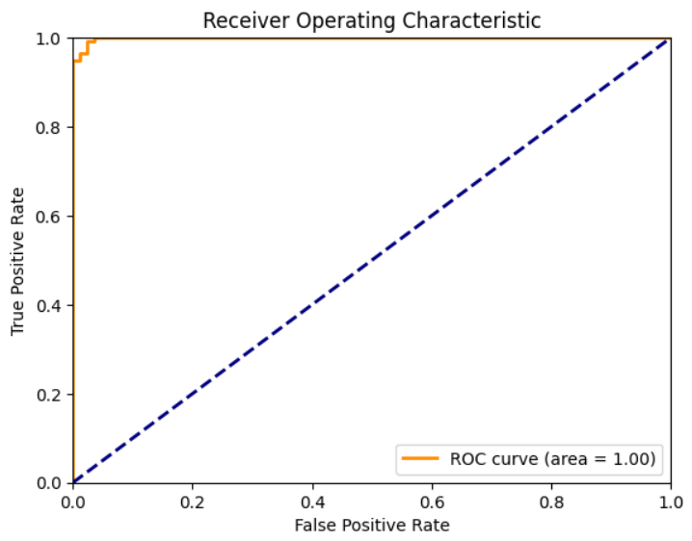
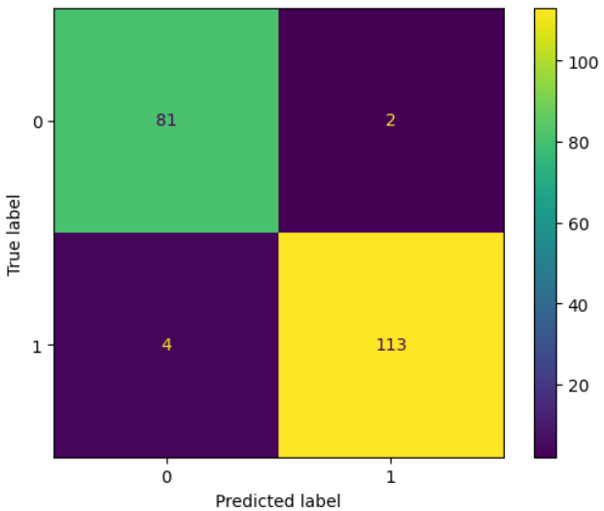
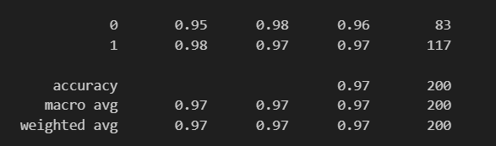
Machine Learning
We have droped the following columns as they are not relevant for the target: patientid, exerciseangia, age, gender, oldpeak

Slide 11
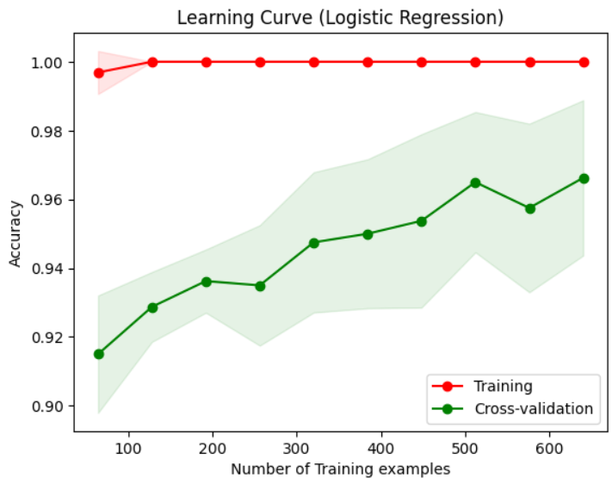
Machine Learning
We have droped the following columns as they are not relevant for the target: patientid, exerciseangia, age, gender, oldpeak

Slide 12
Index
Back End
Data exploration and cleaning
Analysis
Machine Learning
Front End

Slide 13
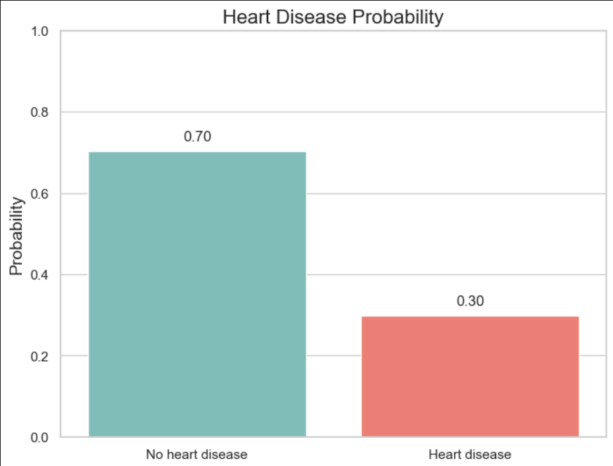
Results
Based on your profile, here are some recommendations to improve your health:
- Chest pain type 0 indicates typical angina. Consider a medical evaluation to determine the cause.
- High serum cholesterol levels may increase the risk of heart disease. Switch to a low-cholesterol diet and consult a physician.
- Abnormalities in the electrocardiogram may indicate heart issues. Additional tests are recommended to assess heart health.
- Your maximum heart rate is high. Consider a cardiovascular evaluation and adjust your exercise regimen accordingly.

Slide 14
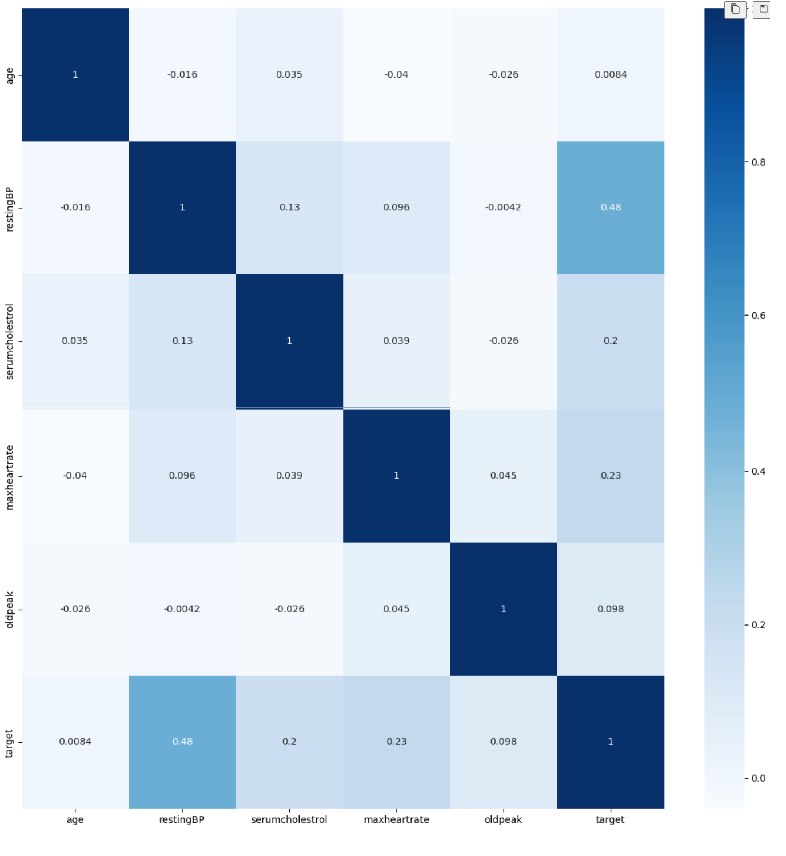
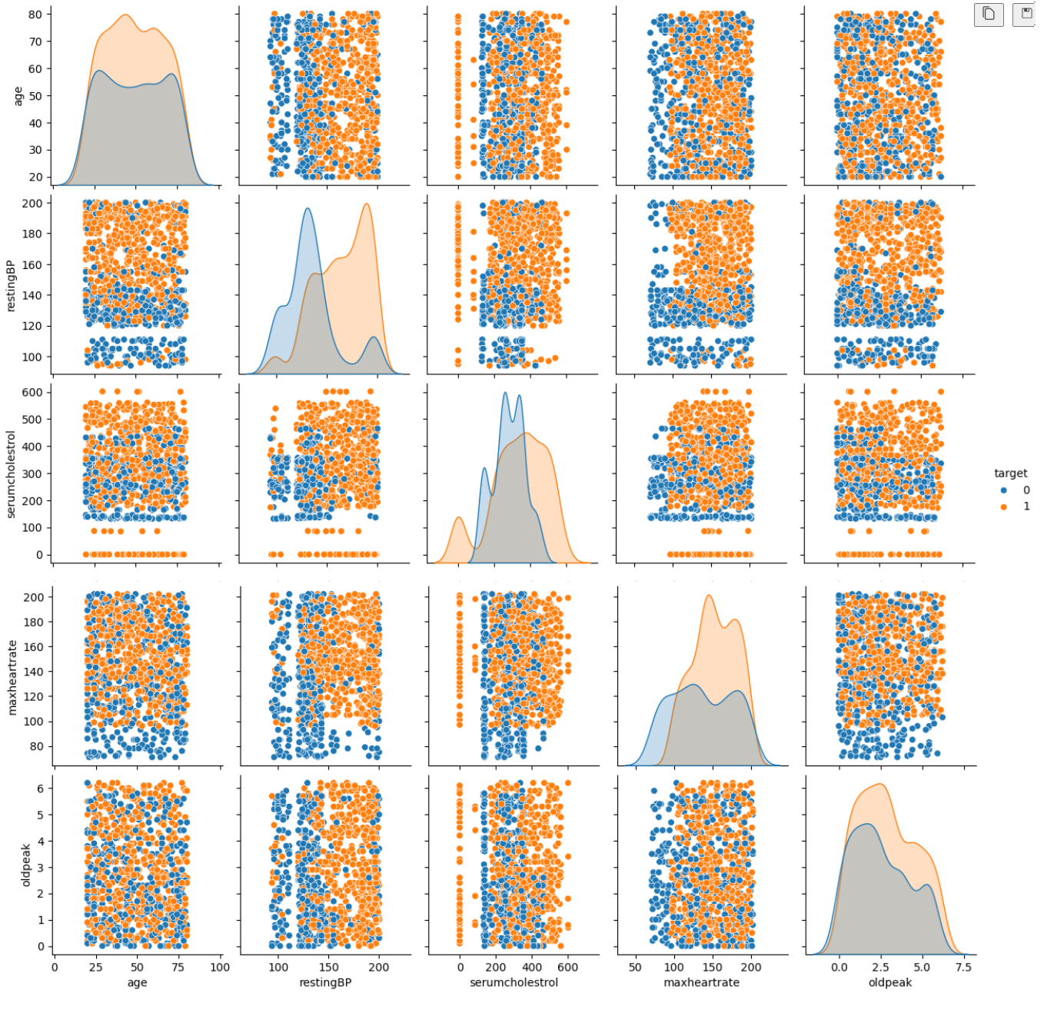
Appendix: Numerical analysis vs Target

Slide 15
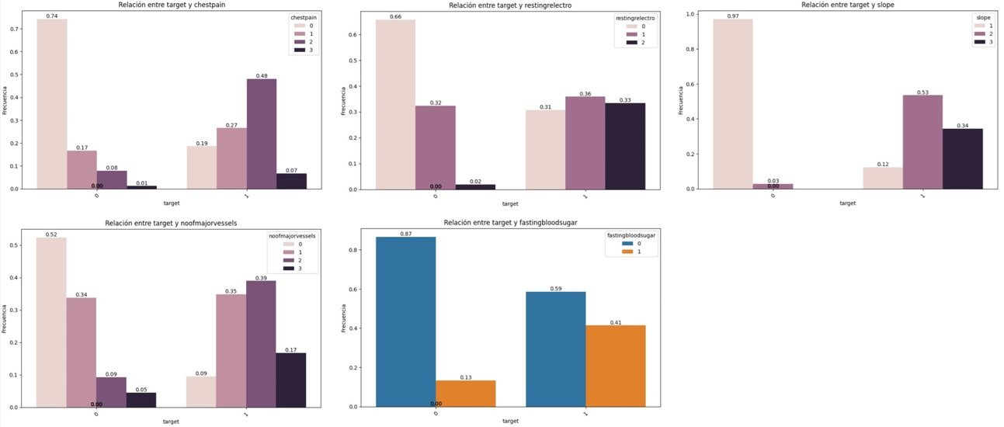
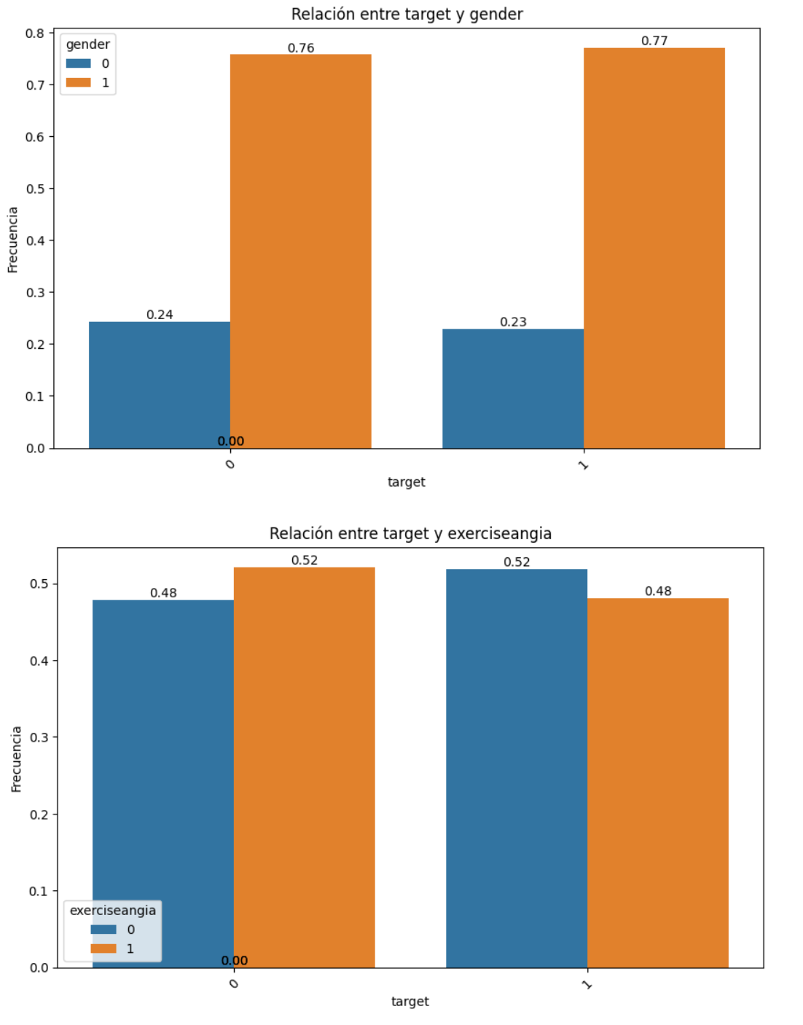
Appendix: Categorical analysis vs Target

Slide 16
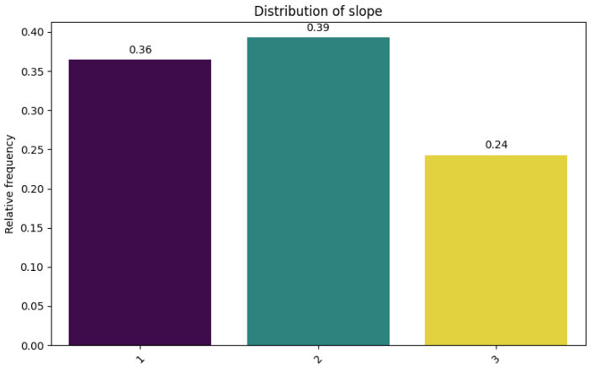
Appendix: slope analysis
Slope deleting those rows with slope = 0 Slope applying ML in those rows with slope = 0

Slide 17
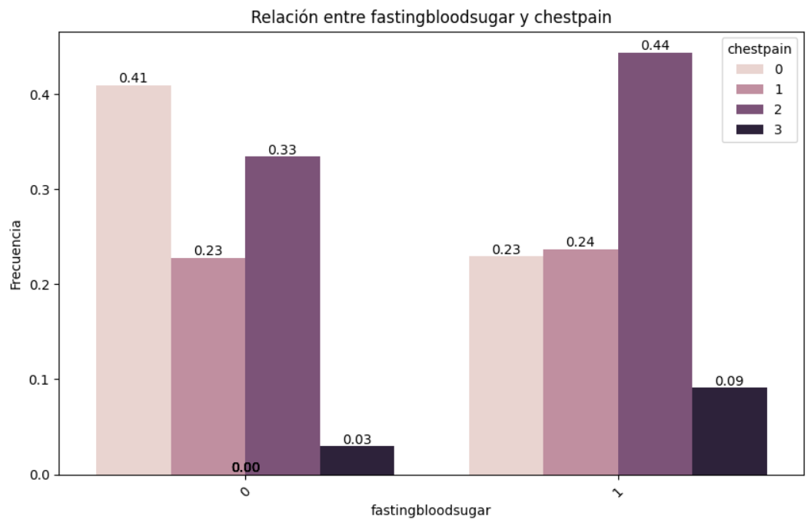
Appendix: Curiosities
Fasting blood sugar | Chest pain type
fastingbloodsugar | chestpain
0,1 > 120 mg/dl (0 = false, 1 = true) | Value 0: typical angina, Value 1: atypical angina, Value 2: non-anginal pain, Value 3: asymptomatic

Slide 18
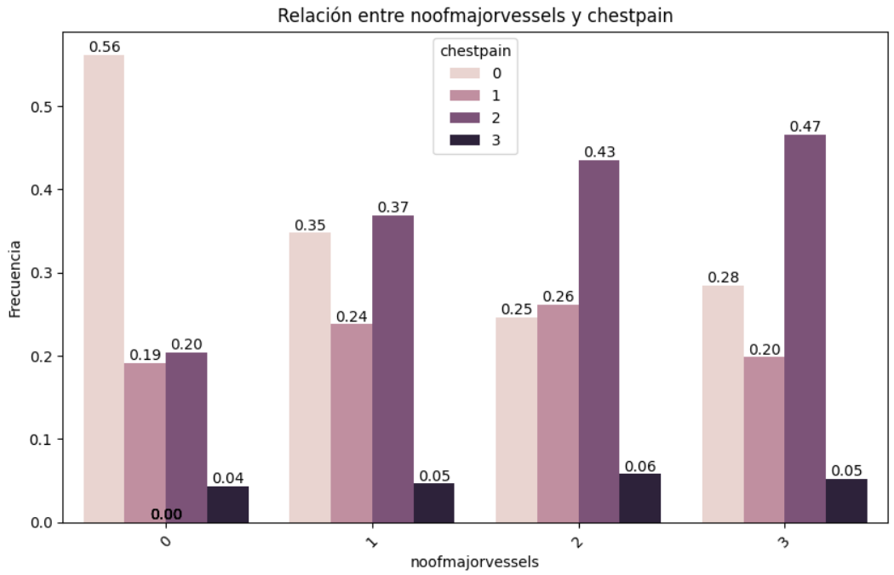
Appendix: Curiosities
Number of major vessels | Chest pain type
noofmajorvessels | chestpain
Value 0: 0 vessels affected Value 1: 1 vessel affected Value 2: 2 vessels affected Value 3: 3 vessels affected | Value 0: typical angina, Value 1: atypical angina, Value 2: non-anginal pain, Value 3: asymptomatic

